Slide 1
HTML
(Hyper Text Markup Language)

Slide 2
Basic Structure
<!DOCTYPE html>
<html>
<head>
<title>This is title</title>
</head>
<body>
<!-- write something here -->
</body>
</html>

Slide 3
The basic structure for all HTML documents is simple
and should include the following minimum elements
or tags:
<html>- The main container for HTML pages
<head> - The container for page header information
<title>- The title of the page
<body>- The main body of the page

Slide 4
<!DOCTYPE >- declaration is not an HTML tag.
It is an instruction to the web browser (the document type) and HTML
Version.
<!DOCTYPE html> (HTML 5 )
<!DOCTYPE HTML PUBLIC "-//W3C//DTD HTML 4.01//EN“ "http://www.w3.org/TR/html4/strict.dtd"> (HTML 4.01 Strict)
(This DTD contains all HTML elements and attributes, but does NOT
INCLUDE presentational or deprecated elements (like font). Framesets are
not allowed.)
<!DOCTYPE HTML PUBLIC "-//W3C//DTD HTML 4.01 Transitional//EN"
"http://www.w3.org/TR/html4/loose.dtd"> (HTML 4.0.1 Transitional )
This DTD contains all HTML elements and attributes, INCLUDING
presentational and deprecated elements (like font). Framesets are not
allowed.
<!DOCTYPE HTML PUBLIC "-//W3C//DTD HTML 4.01 Frameset//EN" "http://www.w3.org/TR/html4/frameset.dtd"> (HTML 4.01 Frameset )
This DTD is equal to HTML 4.01 Transitional, but allows the use of frameset content.

Slide 5
Body Element
<body attribute name=“attribute name”>
Attribute | Options | Functions
align | left, right and center | Horizontally align tags
valign | top, middle and bottom | Vertically align tags
bgcolor | Numeric, hexadecimal and RGB value | Place background color behind an element
background | URL | Place background image behind element
id (core attribute) | User Defined | Unique name for an element (specially used for CSS)
class (core attribute) | User defined | Clssifies an element (specially used for CSS)

Slide 6
Attribute | Options | Functions
width | Numeric Value | Specifies the width of table(and its element), image and body. <canvas>, <iframe>, <img>,
height | Numeric Value | Specifies the height of table, div, images and other
title (core attribute) | User defined | Popup name for element
Style (core attribute) | User defined | styling elements

Slide 7
Heading Tag
Supported Attribute: align
<!DOCTYPE html>
<html>
<head>
<title>This is title</title>
</head>
<body>
<h1>This is level one heading </h1>
<h2>This is level two heading</h2>
<h3>This is level three heading</h3>
<h4>This is level Four heading </h4>
<h5>This is level Four heading </h5>
<h6>This is level Four heading </h6>
</body>
</html>

Slide 8
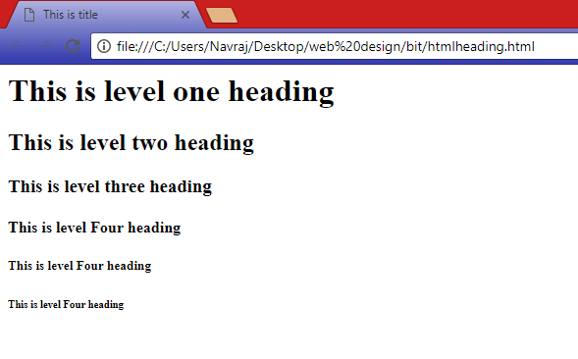

Slide 9
Paragraph Tag
The <p> tag offers a way to structure your text into different paragraphs. Each
paragraph of text should go in between an opening <p> and a closing </p>
Tag. Supported Attribute: align
<html>
<head>
<title>This is title</title>
</head>
<body>
<font color=“white”>This is paragraph</font>
<p align=“center”>this is an another paragraph</p>
</body>
</html>

Slide 10
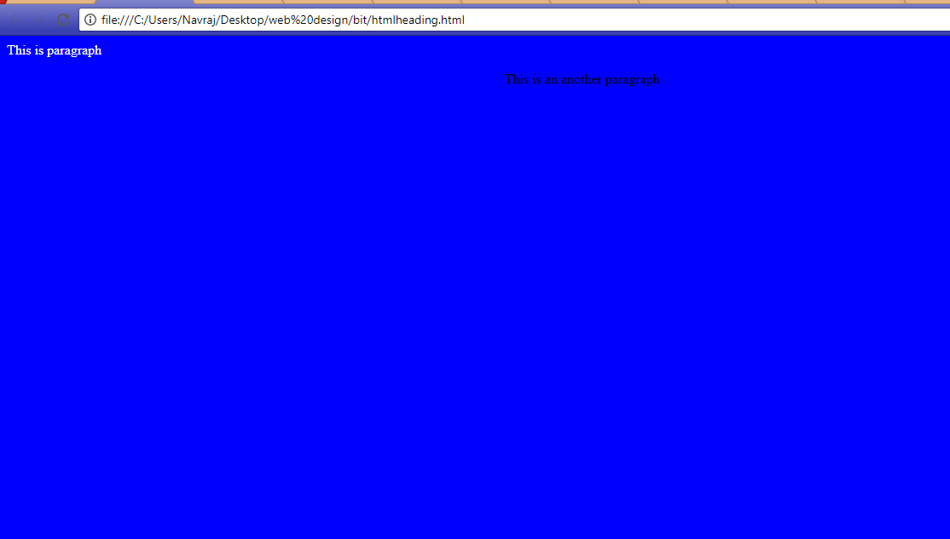

Slide 11
Font Tag
The <font> tag specifies the font face, font size, and color of text.
So supported attributes are face for font family, size for font size and color for flow color for it.
<font face=“Arial” size=“18” color=“red”>This is paragraph</font>
Color Codes
We can define color or bgcolor value as predefined color (for example red, green, blue, white etc.)
All the colors can be specified as a six character or three character hexadecimal value:
RRGGBB or RGB (R=Red, G=Green and B= Blue)
(FF0000 – red) (888888 – gray) (004400 – dark green) (FFFF00 – yellow)

Slide 12
Html Table
The HTML tables allow us to arrange data like text, images, links, other tables, etc. into rows and columns of cells.
The HTML tables are created using the <table> tag.
<tr> tag is used to create table rows.
<td> & <th> tag is used to create data cells. The elements under <td> are regular and left aligned by default.
<caption> tag is used to defines a table caption. tag must be inserted immediately after the <table> tag. You can specify only one caption per table.
bgcolor, background, bordercolor, width, attributes are used in table tag.

Slide 13
Table attributes and values
Attribute | Options | Functions
align | left, right and center | Horizontally align table
border | 1,0 | Specify border
bgcolor | Numeric, hexadecimal and RGB value | Place background color behind table
background | URL | Place background image behind table
cellpadding | Number in pixel | Specifies the space between the cell wall and the cell content
cellspacing | Number in pixel | Specifies the space between cells

Slide 14
Attribute | Options | Functions
frame | Void, above, below, hsides, lhs, rhs, vsides, box, border | Border lines outside table
rules | None, groups, rows, cols, all | Border lines inside table
rowspan | number | to merge two or more rows in single row
colspan | number | to merge two or more column in single column

Slide 15
Table Header, Body, and Footer
Tables can be divided into a header, a body, and a foot.
head and foot are rather similar to headers and footers in a word-processed document that remain the same for every page, while the body is the main content holder of the table.
<thead> − to create a separate table header.
<tbody> − to indicate the main body of the table.
<tfoot> − to create a separate table footer.
Nested Tables
one table inside another table.

Slide 16
Complete Table Example
<html>
<head>
<title>HTML Table Background</title>
</head>
<body>
<table border = “1“ width="400">
<caption align="bottom">fig: table 1</caption>
<thead>
<tr>
<th colspan="3" align="center">This is table header</th>
</tr>
</thead>
<tfoot>
<tr>
<th colspan=“3” align=“center”>This is table footer</th>
</tr>
</tfoot>
<tbody>
<tr>
<th>SN</th>
<th>Name</th>
<th>Marks</th>
</tr>
<tr>
<td>1</td>
<th>Ram</th>
<th>100</th>
</tr>
<tbody>
</table>
</body>
</html>

Slide 17
HTML lists
Lists are used to group together related pieces of information so they are clearly associated with each other and easy to read.
frequently used for navigation as well as general content.
help create a well-structured, more accessible, easy-to-maintain document.
There are three types of lists. Unordered List, Ordered List and Description List

Slide 18
Unordered List
unordered list is a collection of related items that have no special order or sequence.
<ul> tag is used to create this type of list.
Each item In this list is marked with a bullet.
Example:
<html>
<head>
<title>HTML Unordered List</title>
</head>
<body>
<ul>
<li>List One</li>
<li>List Two</li>
<li>List Three</li>
<li>List Four</li>
</ul>
</body>
</html>
Output
List One
List Two
List Three
List Four

Slide 19
Type Attribute
type attribute for <ul> tag to specify the type of bullet.
The possible values for type attribute are disc, square and circle.
Example:
<ul type=“circle”>
<li>List One</li>
<li>List Two</li>
<li>List Three</li>
<li>List Four</li>
</ul>
Another Example:
<ul type=“square”>
<li>List One</li>
<li>List Two</li>
<li>List Three</li>
<li>List Four</li>
</ul>
By default unordered list specify disc value for its type attribute.
Output
List One
List Two
List Three
List Four
Output
List One
List Two
List Three
List Four

Slide 20
Ordered List
Also called numbered list.
Used when we required to put list in specific order then this list is used.
created by using <ol> tag
Example:
<html>
<head>
<title>HTML Ordered List</title>
</head>
<body>
<ol>
<li>List One</li>
<li>List Two</li>
<li>List Three</li>
<li>List Four</li>
</ol>
</body>
</html>
Output
List One
List Two
List Three
List Four

Slide 21
Type Attribute
type attribute for <ol> tag to specify the type of number or order.
start attribute for <ol> tag to specify the starting point of numbering we need
The possible values for type attribute are .
<ol type = "1"> - Default-Case Numerals.
<ol type = "I"> - Upper-Case Roman Numerals.
<ol type = "i"> - Lower-Case Roman Numerals.
<ol type = "A"> - Upper-Case Letters.
<ol type = "a"> - Lower-Case Letters.
Another Example:
<ol type=“i” start=“4”>
<li>List One</li>
<li>List Two</li>
<li>List Three</li>
<li>List Four</li>
</ol>
Output (for type=“i” start=“4”)
List One
List Two
List Three
List Four
Output (for type=“A”)
List One
List Two
List Three
List Four

Slide 22
HTML Description Lists
ideal way to present a glossary, list of terms, or other name/value list.
Both HTML and XHTML supports this list
<dl> tag is used to create definition list.
<dt> and <dd> tags are wrapped inside <dl> tag where <dt> is definition term and <dd> is description for term.
Example:
<html>
<head>
<title>HTML Ordered List</title>
</head>
<body>
<dl> <dt>Term One</dt> <dd>This is description</dd> <dt>Term Two</dt> <dd> This is description</dd> </dl>
</body>
</html>
Output
Term One
This is description
Term Two
This is description

Slide 23
Physical Character Styles
<h1>physical character styles</h1>
<b>bold</b><br>
<i>italic</i><br>
<tt>teletype (monospaced)</tt><br>
<u>underlined</u><br>
subscripts: f<sub>0</sub> + f<sub>1</sub><br>
superscripts: x<sup>2</sup> + y<sup>2</sup><br>
<small>smaller</small><br>
<big>bigger</big><br>
<strike>strike through</strike><br>
<b><i>bold italic</i></b><br>
<big><tt>big monospaced</tt></big><br>
<small><i>small italic</i></small><br>
<font color="gray">gray</font><br>
<del>delete</del><br>
<ins>insert</ins><br>

Slide 24
